Slide 1

Predicting Car Accident Severity
By Hetal Patel

Slide 2
Introduction / Business Problem
The main point of this project is to be able to predict the severity of an accident.
Being able to predict the severity of an accident will help to allocate resources better whether it is police or medical staff.
We have a number of features available to us in order to help us give accurate predictions.

Slide 3
Data
The data provides us an insight into the accidents in Seattle, the data covers the years 2004 till 2020.
There are a total of 194,673 accident records and 38 variables in our data set.
Our dependable variables are the severity code and the severity desc.

Slide 4
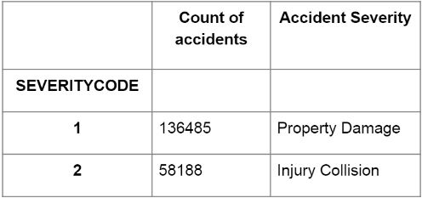
Data Pre-processing
We tried to reduce as much of the data as we could so that we had a clean data set available to work on.
Even though initially there were several columns that could have helped in our investigation in the end it came down to just a few.
Severity code has been divided as below.

Slide 5
Pre-processing Continued
In our large selection of variables there were some that definitely stood out for me.
Weather
RoadCond
LightCond
VehCount
PedCount
Initially both VehCount and PedCount was an interesting corelation to be seen however due to the amount of data missing both could not be used. Leaving us with only the first three variables.

Slide 6
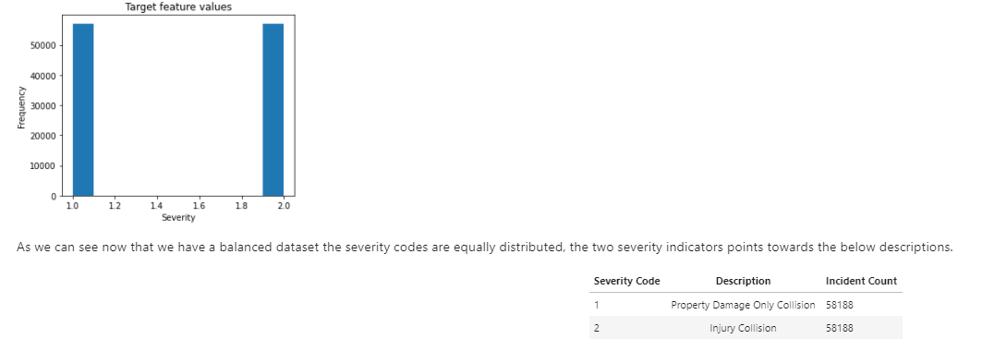
Pre-processing Continued
Prior to working on the charts and figures we needed to ensure that our data was balanced. Having a balanced data set ensures that we do not have a bias and the outcome is fairly chosen.

Slide 7
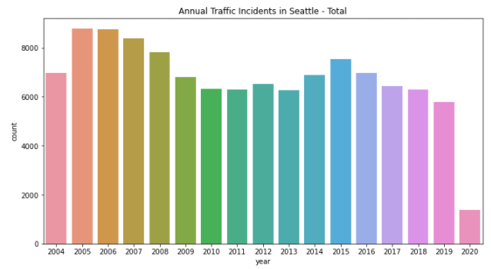
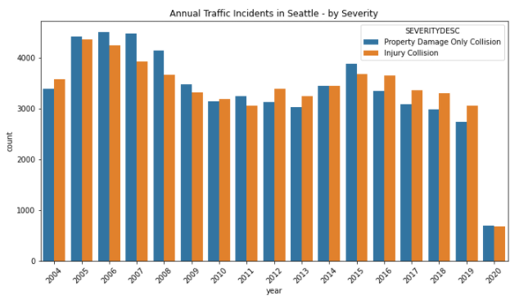
Annual Traffic Incidents vs Severity
Annual Traffic Incidents
Accident Severity
The above graphs show us the spread of the total number of accidents from 2004 to 2020. As well as the spread in the severity of the accidents.
One thing to note is that in currently in 2020 we are going through a pandemic and that may be what is affecting the number of incidents in 2020.

Slide 8
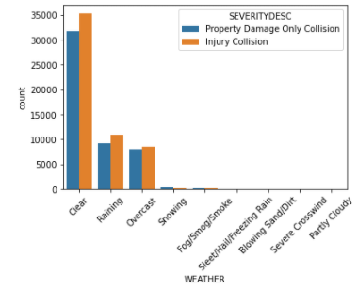
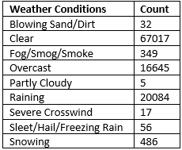
Weather
Weather conditions are usually the thing that affect the traffic incidents the most the below chart shows us which conditions have caused the most severity.

Slide 9
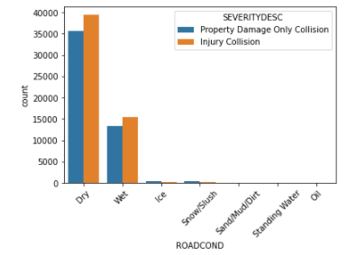
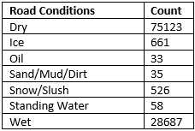
Road Conditions
Road conditions when combined with weather often lead to the most unreliable conditions when driving. The below charts show the severity as well as road conditions.

Slide 10
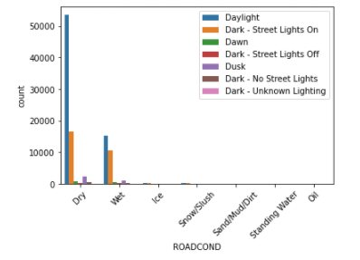
Road Conditions and Light
Another observation with the road conditions was the light conditions. Here we wanted to see whether the light conditions affected the number of incidents on various road conditions.

Slide 11
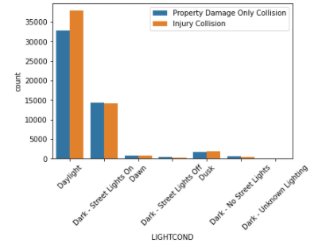
Light Conditions
Taking the knowledge from the road vs light scenario we are now looking at how light conditions affect the severity

Slide 12
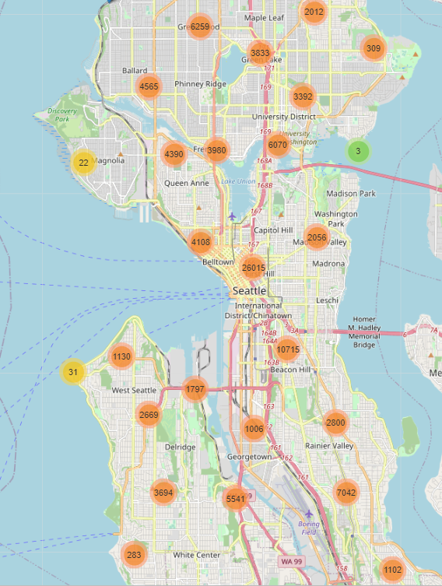
Location Analysis
As the data we are given is providing us incidents from all over Seattle it is only fit to understand the areas where the most number of incidents have occurred
The map to the left shows various points across Seattle and the corresponding number of incidents that have occurred there.

Slide 13
Methodology & Modelling
In order to build an accurate model we will use the training set.
Then make use of the test set to gauge the accuracy of the individual models.
The following algorithms will be used
K Nearest Neighbours
Decision Tree
Support Vector Machine
Logistic Regression

Slide 14
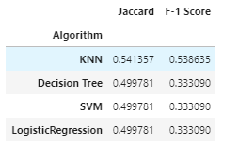
Conclusion
The purpose of this project was explore and understand the relationship between traffic accident severity and various characteristics that give insight to the situation. From the available 38 features we have gone on to select just 5 that we feel summarize the relationship as best as possible. An accuracy of 54% has been achieved and it is clear that the features that have been highlighted do have an impact on the severity of an accident. There is scope for improvement provided that additional variables are available, these can be a mix of variables we already have and other external variables. An example of this can be the last time of service, car safety features (for example air bags, anti lock breaks, electronic stability control, traction control).

